Slide 1

Estimating the impact of crime risks on property values
Abdullah Al Jubayed
Applied Economics Project
Western Kentucky University
Project Supervisor: Dr. Stephen Locke

Slide 2
Introduction
Property values and crime risk are two sides of a seesaw, with an increase in one often resulting in a decrease in the other
This paper is to examine the impact of sex offenders on their neighborhood’s property values in Warren County, Kentucky
Re-commit crime which leads us to think about their presence and impact

Slide 3
Present Scenario of the United States
As of February 2023,
The total number of sex offenders in the US is 786,838
The total number has increased by about three percent this year
Oregon, Arkansas, and Alaska have the largest registries of convicted sex offenders per capita.
Texas (100,000) and California(62,000) have the highest number
Vermont and Rhode Island each have roughly 1,000 offenders
Kentucky has 9362 convicted sex offenders and the rate is 207 per 100,000 residents
Warren County has 142 registered sex offenders as of December 2022

Slide 4

Literature Review

Slide 5
Crime Rates vs Property Value
Employing a hedonic pricing model on one year of data from Rochester, NY 1971, Richard Thaler (1978) identifies a one-standard-deviation increase in property crime per capita drop in house value by around 3%.
Steve Gibbons (2004) finds a decrease in property values of 10 percent for a one-standard-deviation increase in property crime, using a semiparametric model.
Notes:
Several studies have been conducted on crime rates and property values. Gibbons used inner London property data, from December 2000, July 2001, and crime data from April 1999 to March 2001

Slide 6
Crime Risk vs Property Value
Larsen et al. (2003) found 17.4% less property value with an offender presence within a 0.1-mile radius in Montgomery County, Ohio, and less impact within a 0.2-mile radius.
Jaren C. Pope (2007) documented a drop of 2.3 % in home sale prices within the same radius in Hillsborough County, Florida.
Linden and Rockoff (2008) estimated house prices in Mecklenburg County, North Carolina decreased by 4% within a tenth of a mile from an offender's residence, their empirical strategy was DID.
Caudill et al. (2015) investigated property values within both 1 mile and 0.1-mile radius of a sex offender’s residence in Shelby County, Tennessee. They found a 7% and 14 % reduction in value respectively. Also, they found a 2% decline in price with an additional offender presence in 1 mile. They use Zip codes and I have used census tract.
Peiyong Yu (2016) examined a similar study in Rochester, NY, and found 7%,6%, and 3% drops with 0.1 miles, between 0.1 and 0.2 miles, and between 0.2 and 0.3-mile radii, respectively.
Notes:
Limited research has been conducted to explore the link between the residential locations of sex offenders and property values.

Slide 7
Data
Two sets of data
Sex Offender’s Registry as of December 2022 the number of offenders 142: contains basic demographics, conviction date, current address, the status of supervised release, victims' age, and type of offense
Warren County Property Records 2012-2021 and the raw housing data 16814: provide details on housing characteristics, sale information, latitude, and longitude, census tracts, and other information regarding each house.
After Cleaning the data ended up with 110 sex offenders and 14450 property records
Notes:
142 sex offenders identified after cleaning data 110 offenders, 16814 property records after cleaning the data 14450.

Slide 8
Empirical Methodology
Four Models
For two radius
Fixed effects: housing characteristics, Sold month and year, and neighborhood
Variables of interest offender density within 1 mile and 0.1-mile who have lived nearby before the house sold

Slide 9
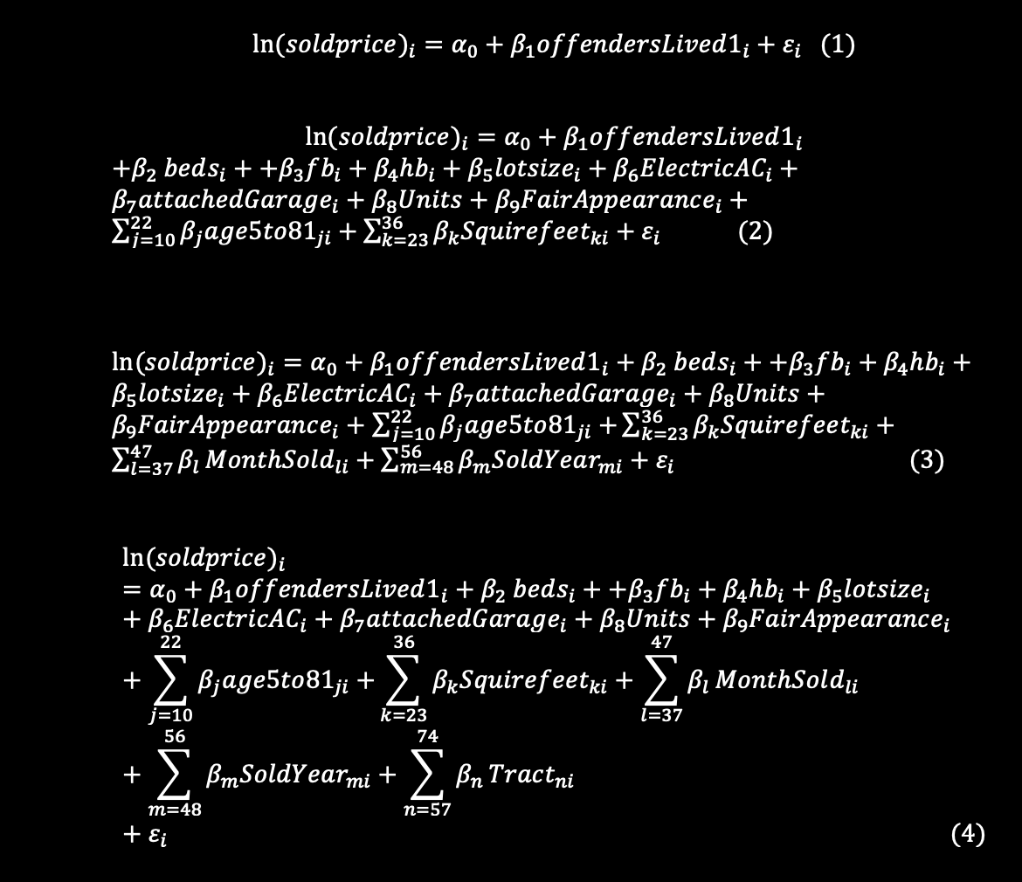
Notes:
13 age dummies, 14 square feet,11 sold month,9 sold year,18 tracts

Slide 10

Findings

Slide 11
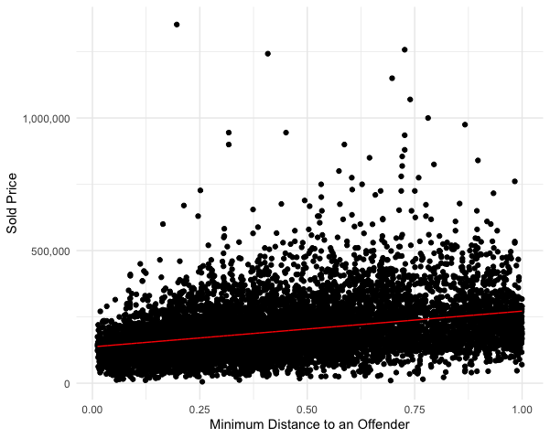
Figure 1 shows the relation between an offender’s minimum distance to a house sold price

Slide 12
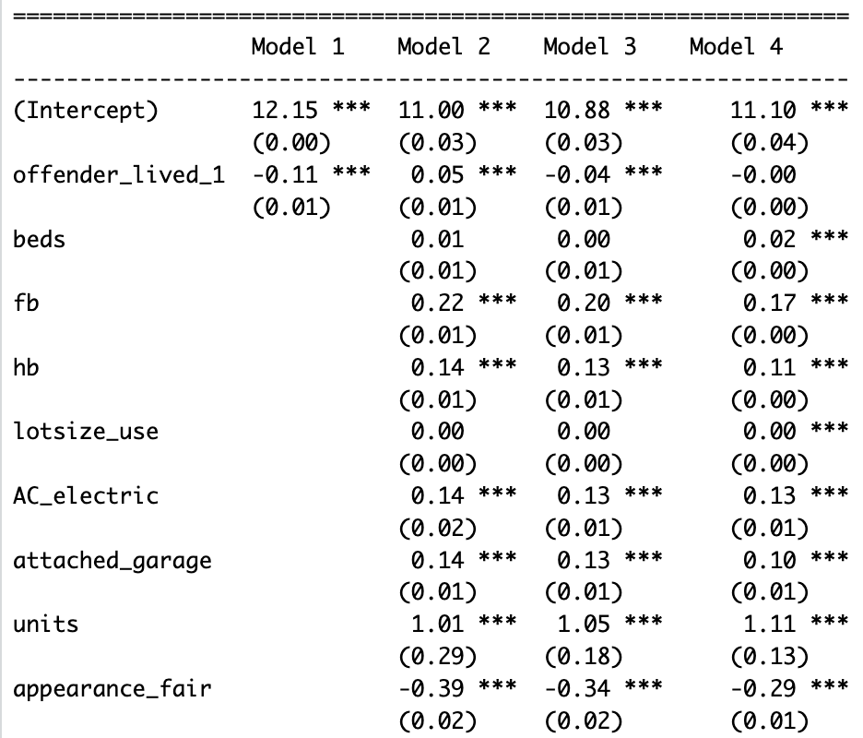
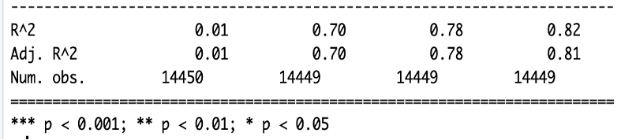
Table 1
1-mile radius offender’s density from a house
Models
On average, an additional offender’s presence declines the sale price by 4%
Notes:
Housing characteristics impacts drop 5%-1% among those variables.

Slide 13
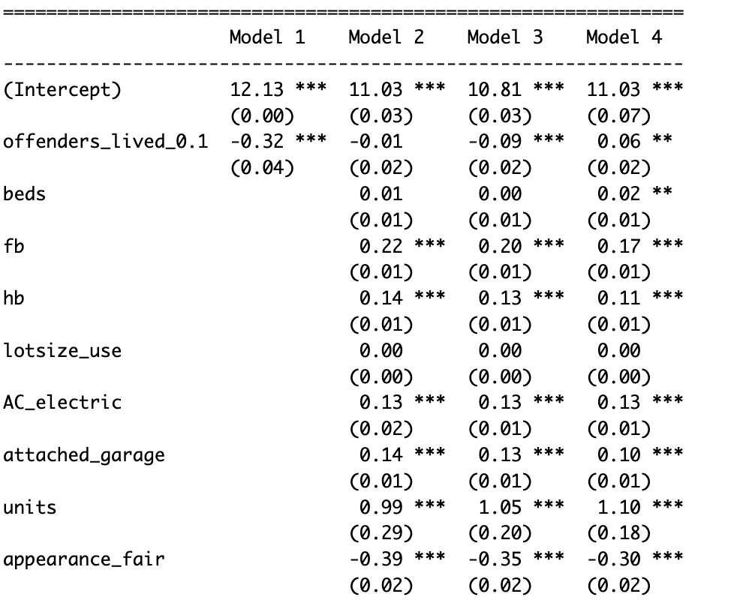

Table 2
Model 4 has a surprising estimate
$R^{2}$ : tracts are not bringing a big variations change than Model 3
Notes:
Surprisingly, it could be that sex offenders tend to live in a neighborhood where the property value is low in which their presence is not impacting the property value of that neighborhood. Model 4 estimates unstable and unreliable coefficients due to the high Variance Inflation Factor (VIF)

Slide 14
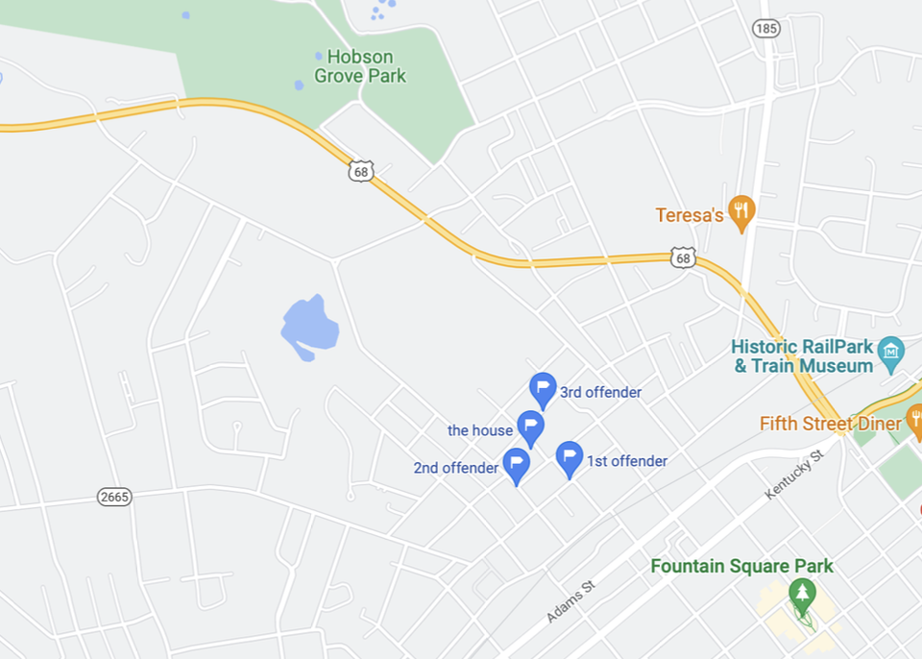
Within 0.1-mile from the house, offenders who have lived within the radius

Slide 15
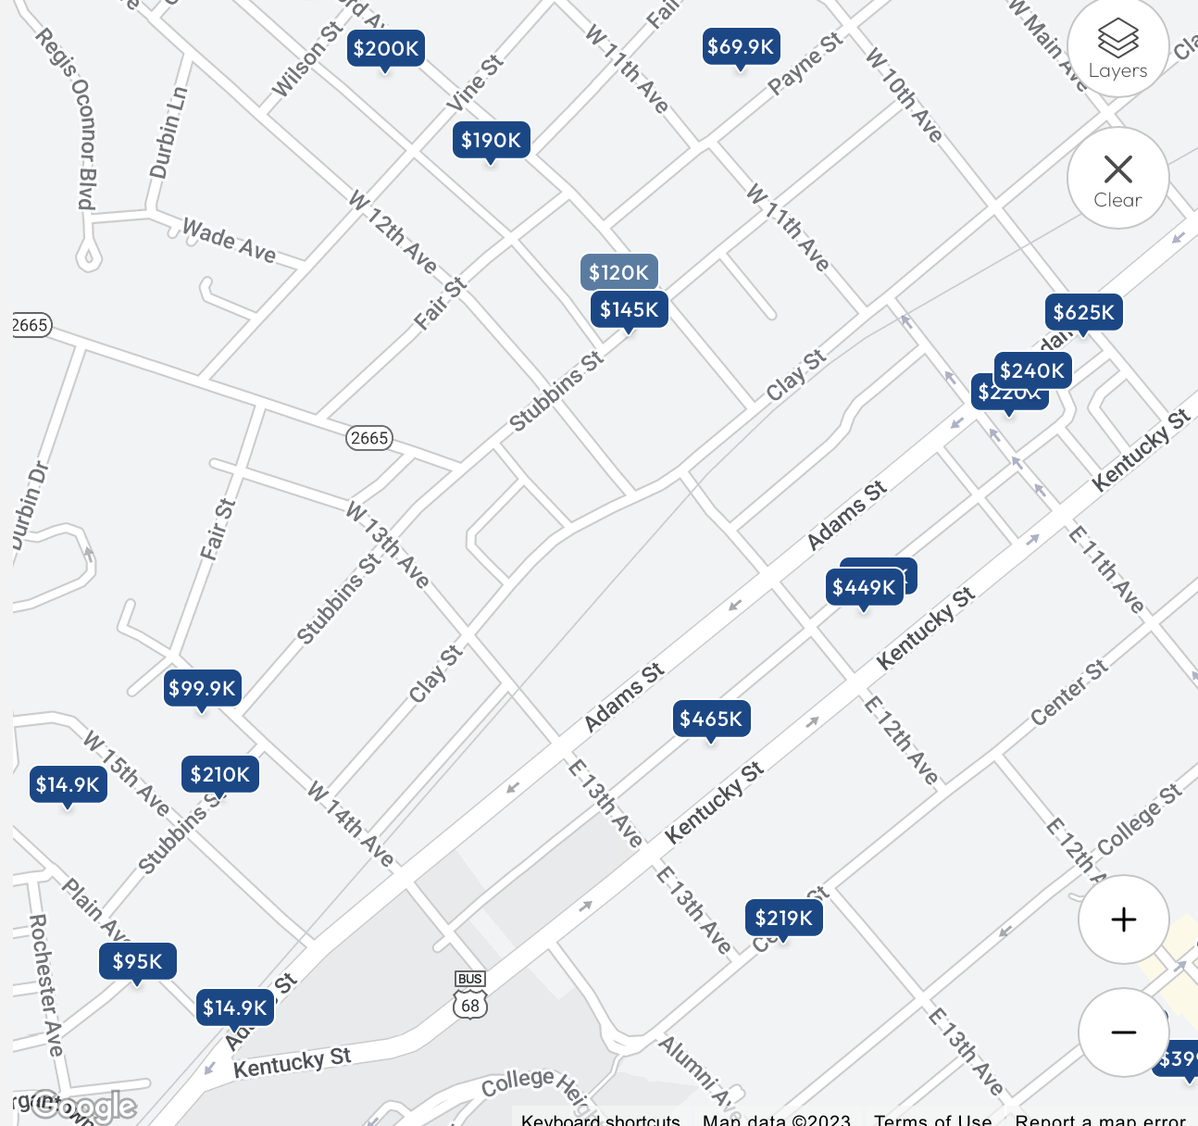
Same property value on RE/MAX
Could be for differences in housing characteristics
Mean property value $210,854

Slide 16
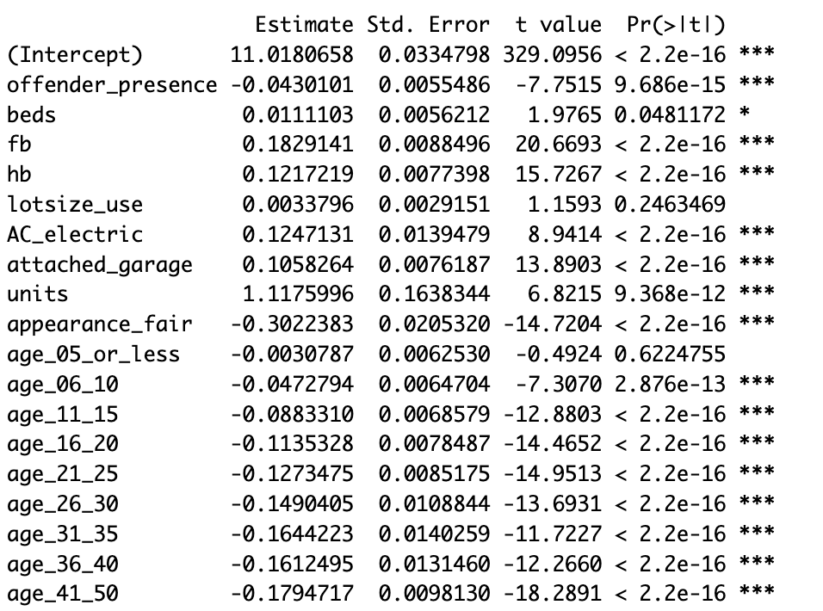
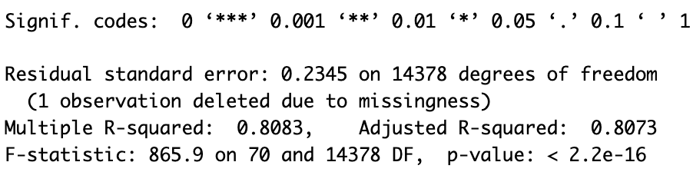
Offender’s presence dummy generated from sex offender density within 1 mile.
Excluding the high VIFs ( exercise)
No change in R^2 compared to Table 1 and Table 2

Slide 17
Comparison of similar study
Name | Estimates(<0.1-mile) | Estimates(<1-mile) | Note
Larsen et al. (2003) | 17.4% |  | Lesser negative impact upto 0.2-mile
Jaren C. Pope (2007) | 2.3%
Linden and Rockoff (2008) | 4% | No statistically significant impact
Caudill et al.(2015) | 14% | 7% | One additional offender within 1-mile 2%
Peiyong Yu(2016) | 7% |  | 0.1-0.2 miles 6% and 0.2-0.3 miles 3%
This paper | 9% | 4% | 4.3% less price than houses without an offender’s presence
Notes:
The difference with existing studies on crime risk and property values may also be because the studies are undertaken for different locations and datasets.

Slide 18
Limitations
In the real world, sex offenders' presence is not random.
The sample size is small
Might exclude unmeasured environmental and social factors that influence the relationship between property values and offender’s density or proximity
Notes:
Community resources(school, parks), Stigma, Neighborhood quality

Slide 19
Future Research
Expanding the study to include more geographic locations and datasets
Conducting further analyses, such as examining spatial autocorrelation, endogeneity, measurement errors in data, unobservable variables, or controlling for additional variables that may be affecting the relationship.

Slide 20
Conclusion
This study suggests that sex offenders not only affecting victims but also wider society by lessening the property values
Property values drop by 4% and 9% within 1 mile and 0.1 miles of a house in Warren County, Kentucky.

Slide 21
References
“Bowling Green, KY Real Estate & Homes for Sale | RE/MAX.” Accessed April 30, 2023. https://www.remax.com/homes-for-sale/ky/bowling-green/city/2108902.
Caudill, Steven B, Ermanno Affuso, and Ming Yang. “Registered Sex Offenders and House Prices: An Hedonic Analysis.” Urban Studies 52, no. 13 (October 1, 2015): 2425–40. https://doi.org/10.1177/0042098014547368.
Gibbons, Steve. “The Costs of Urban Property Crime.” The Economic Journal 114, no. 499 (November 1, 2004): F441–63. https://doi.org/10.1111/j.1468-0297.2004.00254.x.
Linden, Leigh, and Jonah E. Rockoff. “Estimates of the Impact of Crime Risk on Property Values from Megan’s Laws.” American Economic Review 98, no. 3 (June 2008): 1103–27. https://doi.org/10.1257/aer.98.3.1103.
Pope, Jaren C. “Buyer Information and the Hedonic: The Impact of a Seller Disclosure on the Implicit Price for Airport Noise.” Journal of Urban Economics 63, no. 2 (March 1, 2008): 498–516. https://doi.org/10.1016/j.jue.2007.03.003.
SafeHome.org. “How Many Registered Sex Offenders Are In Your State? | SafeHome.” Accessed April 14, 2023. https://www.safehome.org/data/registered-sex-offender-stats/.
“Sex Offender Registration And Notification Act (SORNA),” May 26, 2015. https://www.justice.gov/criminal-ceos/sex-offender-registration-and-notification-act-sorna.
Thaler, Richard. “A Note on the Value of Crime Control: Evidence from the Property Market.” Journal of Urban Economics 5, no. 1 (January 1, 1978): 137–45. https://doi.org/10.1016/0094-1190(78)90042-6.
“U.S. Census Bureau QuickFacts: Warren County, Kentucky.” Accessed April 16, 2023. https://www.census.gov/quickfacts/fact/map/warrencountykentucky/PST045222.
Yu, Peiyong. “Effects of Sex Offenders’ Residential Locations on Property Values Using Both Parametric and Semiparametric Models.” Atlantic Economic Journal 44, no. 3 (September 1, 2016): 277–91. https://doi.org/10.1007/s11293-016-9505-7.

